Slide 1

Minor Project Presentation On
InfoSprout
“ A digital way of generating a birth certificate”
Group Members
Nabina Budha
Preeti Acharya
Melina Giri
Suraj Kumar Chaudhary

Slide 2

INTRODUCTION (1)
A birth certificate confirms child’s nationality
It includes place of birth, parentage, and age
Validity: forever
Processing time: not more than some hours.
InfoSprout is a web-based birth registration system
Speeds, reduces the cost of registration
Keeps registration details for future use

Slide 3
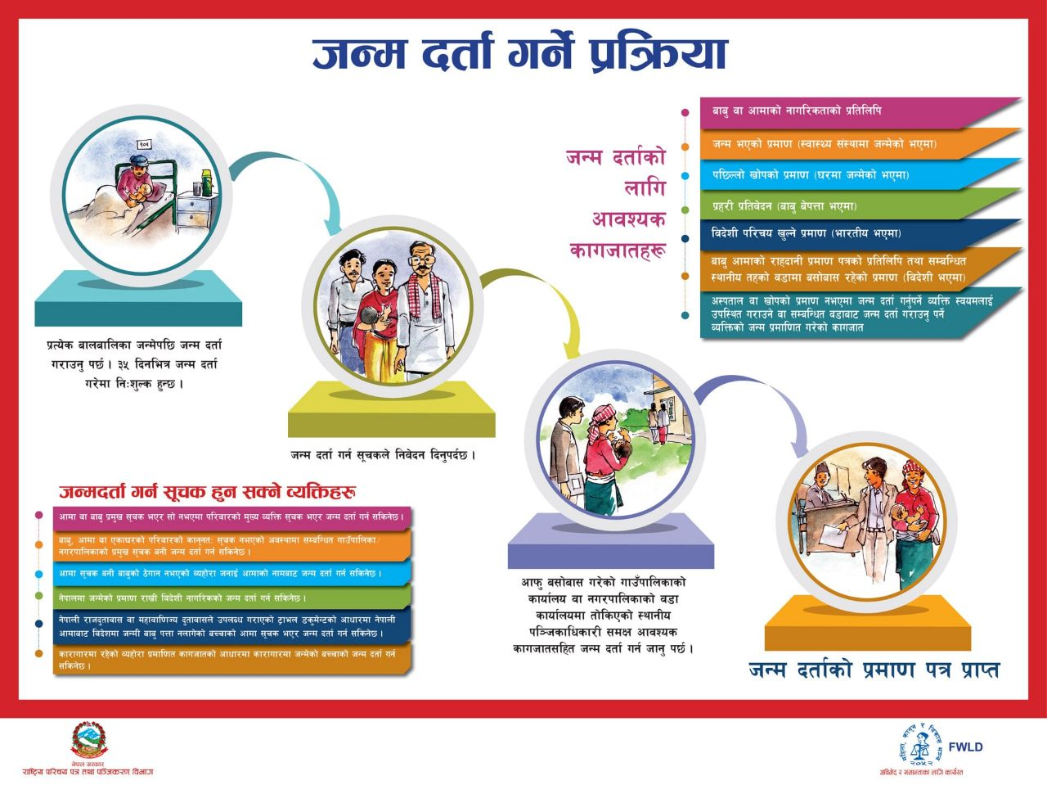
INTRODUCTION (2)
General Workflow
User apply with personal information
“Sachiv” prepare the document
“President” verify / sign the document
Sachiv issue the document

Slide 4
INTRODUCTION (3)
Documents needed
Documents regarding the birth of a child from Hospital
(else documents of witness)
Birth time, date, and place.
Marriage certificate of parents
Citizenship Card of parents
Migration Certificate
Proof of Birth
Required References
Father
Mother
Family Head
Uncles and Brothers
Ward Sachiv
(if he/s is willing to provide a letter with the proof or witness of a child being born in that ward)

Slide 5
INTRODUCTION (4)
Case 1: Normal case
Case 2: Father being Foreigner
Case 3: Single Mother
Case 4: Orphan Case
District main (nagar palika adhyaksha)-> head of the family
Case 5: Loss of Migration Certificate
Make the transmigration certificate -> from the current place/parental place
Case 6: Loss of Documents
Get the letter of approval from the ward head
proof of the existing documents through an image.

Slide 6
PROBLEM STATEMENT
Long processing time
Redundancy and inconsistencies of data
Authority misuse, inaccessibility
Data can be lost or stolen
Data can’t be reused

Slide 7
OBJECTIVES
Design and Implement an online database
Support access to a centralized database
Automatically stores & retrieves data
Minimize paperwork for Birth Application
Fast recovery, reuse
Easy and cheap

Slide 8
SIGNIFICANCE OF THE STUDY
Proffer solutions to current backdrops
Fostering a more effective and efficient data collection
Storage, processing, and retrieval method
Means for nation planning and population forecasting

Slide 9
LITERATURE REVIEW
Nagarik App
Social Security Fund
DoNIDCR (Department of National ID and Civil Registration)
7

Slide 10
METHODOLOGY
Software Process Model: Incremental model.
First increment is always a core product
In each increments, new features are added
Process continues until the complete system is achieved.
The phases of this model are:
Analysis, Design, Coding and Testing

Slide 11
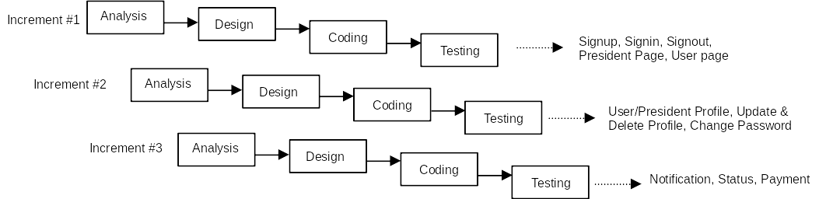
SOFTWARE PROCESS MODEL

Slide 12
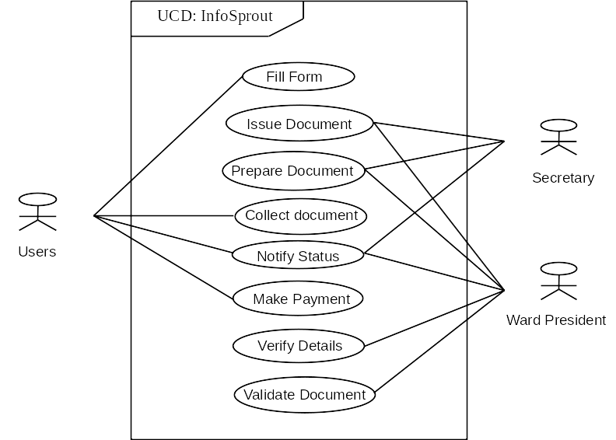
USE-CASE DIAGRAM

Slide 13

DEVELOPMENT TOOLS
Hardware Tools
Laptop
Software Tools
Frontend: Html , css , js, Bootstrap
Backend: php
Database: Mysql

Slide 14
EXPECTED OUTCOMES
Facilitates the easy presentation and report to birth monitoring
The database can store, process, retrieve record, and certify
Flexible: adjust based on changing requirements
Availability of real-time data

Slide 15
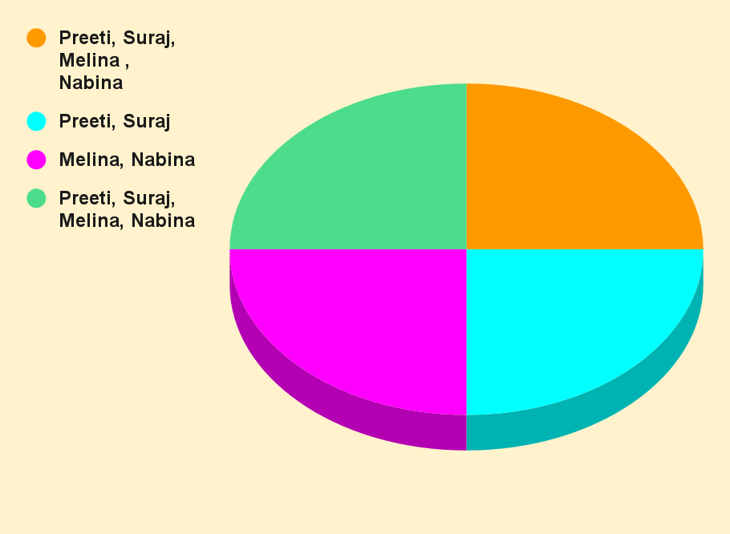
PROJECT SCHEDULE
Testing & Debugging
Analysis
Testing and Debugging
Analysis
Backend & Database
Design & Frontend
Backend & Database
Design & Frontend

Slide 16
Thank You!

